Slide 1
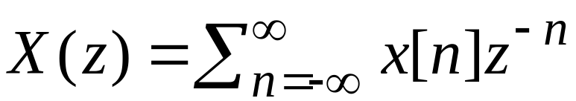
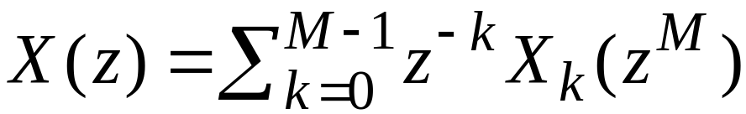

Polyphase Decomposition
The Decomposition
Consider an arbitrary sequence {x[n]} with a z-transform X(z) given by
We can rewrite X(z) as
where

Slide 2
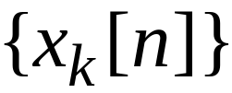
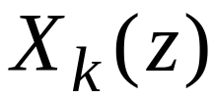
Polyphase Decomposition
The subsequences are called the polyphase components of the parent sequence {x[n]}
The functions , given by the z-transforms of , are called the polyphase components of X(z)

Slide 3
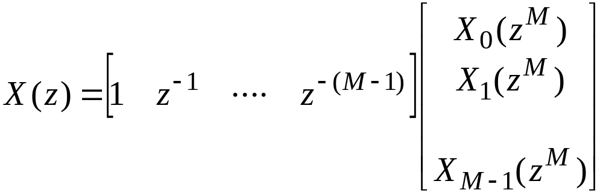
Polyphase Decomposition
The relation between the subsequences and the original sequence {x[n]} are given by
In matrix form we can write

Slide 4
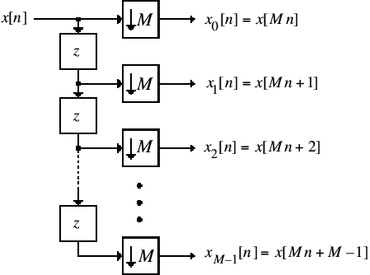
Polyphase Decomposition
A multirate structural interpretation of the polyphase decomposition is given below

Slide 5
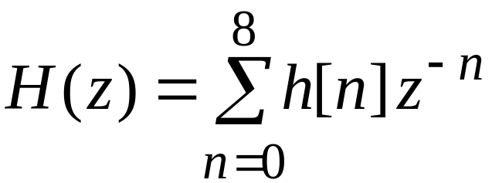
Polyphase Decomposition
The polyphase decomposition of an FIR transfer function can be carried out by inspection
For example, consider a length-9 FIR transfer function:

Slide 6
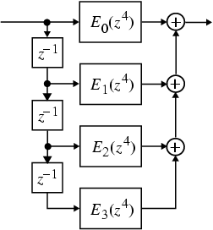
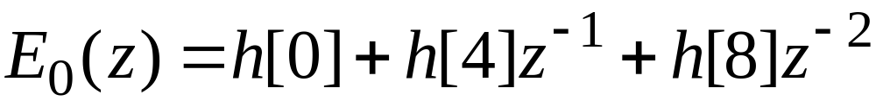
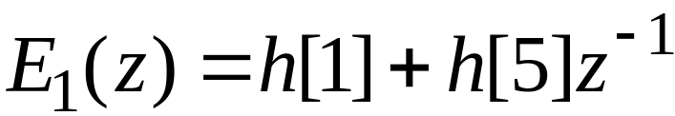
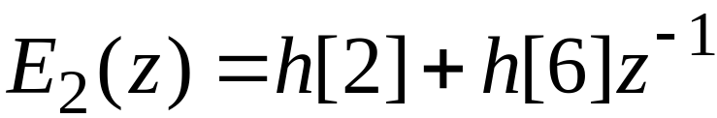
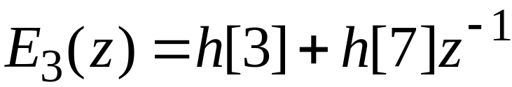
Polyphase Decomposition
Its 4-branch polyphase decomposition is given by
where

Slide 7
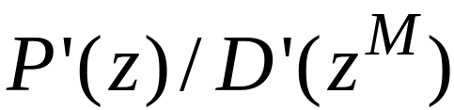

Polyphase Decomposition
The polyphase decomposition of an IIR transfer function H(z) = P(z)/D(z) is not that straight forward
One way to arrive at an M-branch polyphase decomposition of H(z) is to express it in the form by multiplying P(z) and D(z) with an appropriately chosen polynomial and then apply an M-branch polyphase decomposition to

Slide 8
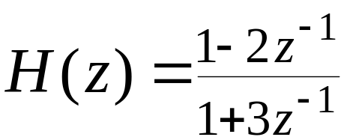
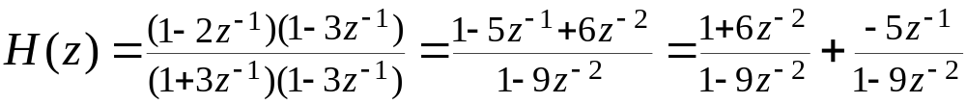
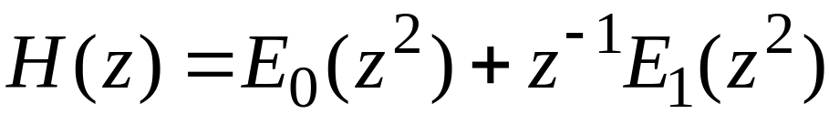
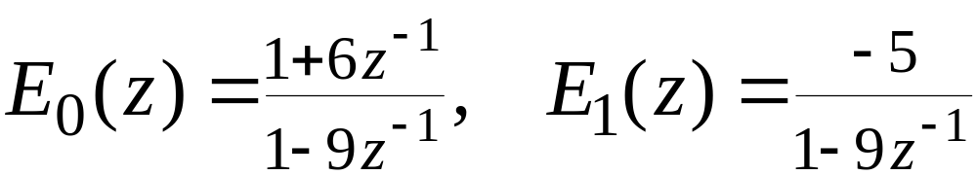
Polyphase Decomposition
Example - Consider
To obtain a 2-band polyphase decomposition we rewrite H(z) as
Therefore,
where

Slide 9
Polyphase Decomposition
Note: The above approach increases the overall order and complexity of H(z)
However, when used in certain multirate structures, the approach may result in a more computationally efficient structure
An alternative more attractive approach is discussed in the following example

Slide 10
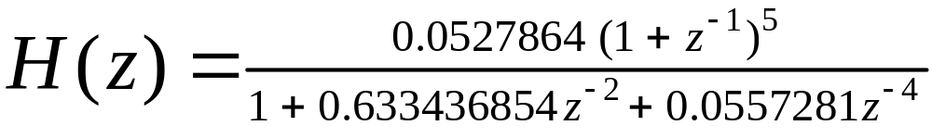
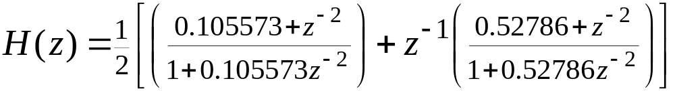
Polyphase Decomposition
Example - Consider the transfer function of a 5-th order Butterworth lowpass filter with a 3-dB cutoff frequency at 0.5π:
It is easy to show that H(z) can be expressed as

Slide 11
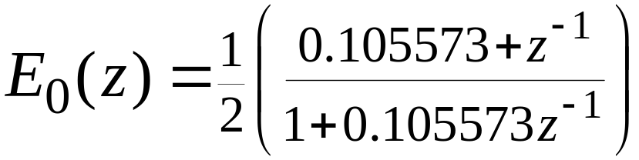
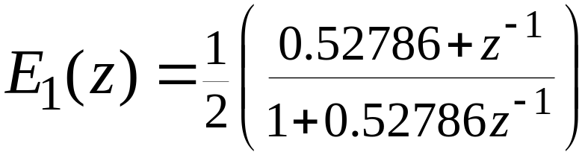
Polyphase Decomposition
Therefore H(z) can be expressed as
where

Slide 12
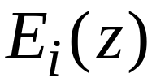
Polyphase Decomposition
Note: In the above polyphase decomposition, branch transfer functions are stable allpass functions
Moreover, the decomposition has not increased the order of the overall transfer function H(z)

Slide 13
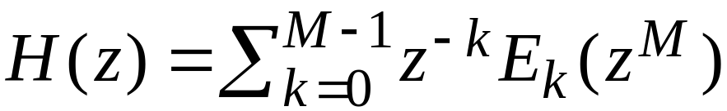
FIR Filter Structures Based on Polyphase Decomposition
We shall demonstrate later that a parallel realization of an FIR transfer function H(z) based on the polyphase decomposition can often result in computationally efficient multirate structures
Consider the M-branch Type I polyphase decomposition of H(z):

Slide 14
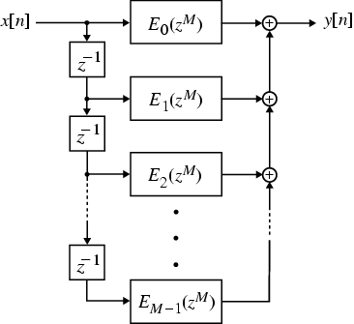
FIR Filter Structures Based on Polyphase Decomposition
A direct realization of H(z) based on the Type I polyphase decomposition is shown below

Slide 15
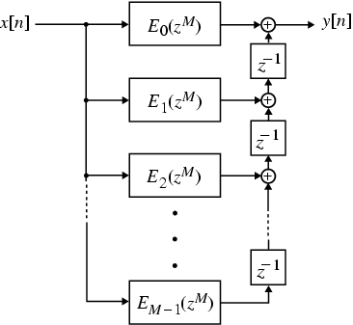
FIR Filter Structures Based on Polyphase Decomposition
The transpose of the Type I polyphase FIR filter structure is indicated below

Slide 16
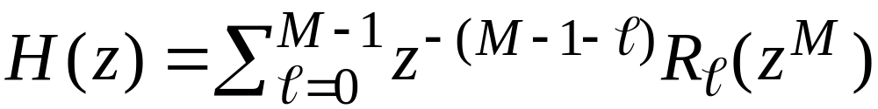
FIR Filter Structures Based on Polyphase Decomposition
An alternative representation of the transpose structure shown on the previous slide is obtained using the notation
Substituting the above notation in the Type I polyphase decomposition we arrive at the Type II polyphase decomposition:

Slide 17
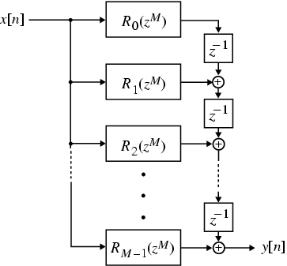
FIR Filter Structures Based on Polyphase Decomposition
A direct realization of H(z) based on the Type II polyphase decomposition is shown below

Slide 18



Computationally Efficient Decimators
Consider first the single-stage factor-of-M decimator structure shown below
We realize the lowpass filter H(z) using the Type I polyphase structure as shown on the next slide
v[n]
M

Slide 19
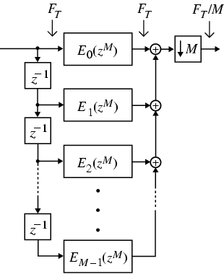
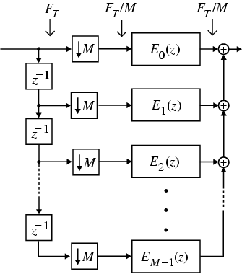

Computationally Efficient Decimators
Using the cascade equivalence #1 we arrive at the computationally efficient decimator structure shown below on the right
x[n]
y[n]
x[n]
y[n]
Decimator structure based on Type I polyphase decomposition

Slide 20
Computationally Efficient Decimators
To illustrate the computational efficiency of the modified decimator structure, assume H(z) to be a length-N structure and the input sampling period to be T = 1
Now the decimator output y[n] in the original structure is obtained by down-sampling the filter output v[n] by a factor of M

Slide 21

Computationally Efficient Decimators
It is thus necessary to compute v[n] at
Computational requirements are therefore N multiplications and additions per output sample being computed
However, as n increases, stored signals in the delay registers change

Slide 22

Computationally Efficient Decimators
Hence, all computations need to be completed in one sampling period, and for the following sampling periods the arithmetic units remain idle
The modified decimator structure also requires N multiplications and additions per output sample being computed

Slide 23
Computationally Efficient Decimators and Interpolators
However, here the arithmetic units are operative at all instants of the output sampling period which is M times that of the input sampling period
Similar savings are also obtained in the case of the interpolator structure developed using the polyphase decomposition

Slide 24
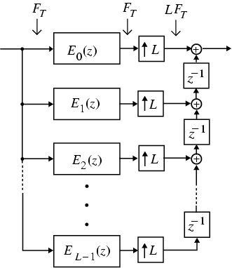
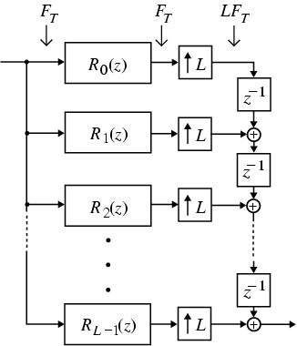
Computationally Efficient Interpolators
Figures below show the computationally efficient interpolator structures
Interpolator based on
Type I polyphase decomposition
Interpolator based on
Type II polyphase decomposition

Slide 25
Computationally Efficient Decimators and Interpolators
More efficient interpolator and decimator structures can be realized by exploiting the symmetry of filter coefficients in the case of linear-phase filters H(z)
Consider for example the realization of a factor-of-3 (M = 3) decimator using a length-12 Type 1 linear-phase FIR lowpass filter

Slide 26
Computationally Efficient Decimators and Interpolators
The corresponding transfer function is
A conventional polyphase decomposition of H(z) yields the following subfilters:

Slide 27

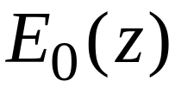

Computationally Efficient Decimators and Interpolators
Note that still has a symmetric impulse response, whereas is the mirror image of
These relations can be made use of in developing a computationally efficient realization using only 6 multipliers and 11 two-input adders as shown on the next slide

Slide 28
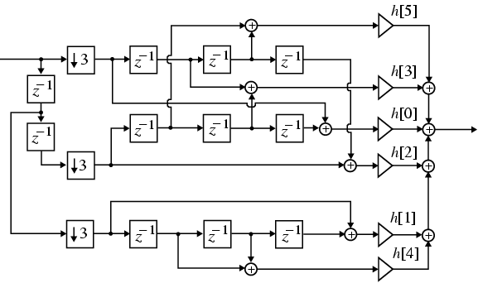
Computationally Efficient Decimators and Interpolators
Factor-of-3 decimator with a linear-phase decimation filter

Slide 29
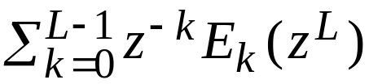
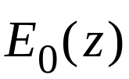
A Useful Identity
The cascade multirate structure shown below appears in a number of applications
Equivalent time-invariant digital filter obtained by expressing H(z) in its L-term Type I polyphase form is shown below
x[n]
L
H(z)
L
y[n]
x[n]
y[n]

